Slide 1
Project Presentation
By : Priti Maurya

Slide 2
Index
1.Company Profile
2.Existing System and need for System
3.Introduction about work
4.Scope of Work
5.Operating Environment – Hardware and Software
6.Detail Description of Technology Used
7.Advantages and disadvantage
Chapter2: Proposed System
Proposed System
Objectives if System
User Requirements
Software Development model(Life cycle model)

Slide 3
Chapter3: Analysis And Design
1. Usecase diagram
2. Class diagram
3. Object diagram
4. Activity diagram
5. Sequence diagram
6. Sit-map diagram
7. ER-diagram
8. Schema diagram
9. Test plans and test cases
10. Drawback and Limitation
11. Proposed Enhancements
12. Conclusion

Slide 4
1. Company profile

Slide 5
Introduction about codebrother
Codebrother is the fastest growing website designing, software development, and digital marketing services provider for small businesses in India. Codebrother help small businesses to make a presence on the web and grow.
at Codebrother , develop professional websites, software, mobile apps, and design attractive Logos.
continuously offering the best hosting, development, and designing services at the lowest price. company main objective is to provide our customers incomparable affordable cheap web hosting, logo designing, and development services and best technical support
We are living in the digital age, where every firm wants to develop its business in the best possible way. It is particularly true for IT firms as they strive hard to serve their clients with the most advanced and best-in-its-class IT services. Codebrother. is your one-stop solution for website design, web development, E-Commerce, portal development services.

Slide 6
Company establishment:
Company name: CodeBrothers.
This company start by Akash Maurya and Gaurav Maurya.
Codeborther is best website development company based in Kanpur .codebrother is more than a website designing company.
Codebrother help business to earn growth and reputed online and locally user-friendly.

Slide 7
Services provided by company
Website Design and Development
Software and Mobile App Development
SEO Services
E-Branding
Graphic and Logo Designing
Digital Marketing

Slide 8
Internship
Internship
Job profile: Assistant developer intern .
Starting date:28/01/2021
Ending date: 28/07/2021
Stipend: Un-paid Internship

Slide 9
Introduction
Online Visiting Card Creation Project will have registration for new Users and login for Members. This software will have Admin Login which will check for new request and orders, User Login in which they can create visiting cards or create their own customize card design.
This Ordered Cards will be delivered to online site they have to print or they have to take online hard copy. The Admin Login will accept request to check design, approve cards request, and create bill.

Slide 10
Modules
Admin
Check Member Information.
Check Card Design.
Create bill according to design and quantity
View Reports.

Slide 11
For User module there are 2 login:
New user login
The new user should first signup and create there
own customize card
Existing User
The existing user the user can check the previous
card update their card and go for new card.

Slide 12
User
Register
Fill Information required to create card
Create Card by choosing Design (or by Uploading Its own design)
Select No Of Cards
Print online

Slide 13
Technology
Html
Css
JavaScript
Php
Laravel
Sql
Bootstrap
Git-hub

Slide 14
Scope of the Project
The scope of the project is to create a visiting card website. The reason behind to create a web based application easily customizable, accessible anywhere, accessible for a range devices, increased security etc.
The advance admin panel is created to monitor the users and handle all the admin related task. There is different role to different admin which are handled by the admin. All the web API are created using Laravel and MYSQL is used as the required database. UML modeling is used to create the basic design and flow of the application and once it is done the actual coding is done. Initially all the required API are created along with the database tables. The required business logic is added to improve the scope of the application and the database connections are established. Few test cases are created and manual testing is used in this project.

Slide 15
Software Requirements & Hardware Components
Software
Windows 7/8/10
Visual studio Code or Notepad++
Xammp server.
Hardware
Processor – Dual Core
Hard Disk – 50 GB
Memory – 1GB RAM

Slide 16
Detail Description of Technology Used
When author has been told to work on Visiting card, author asked slove sir which technologies author need to learn to work this project. He gave me a list of technologies and author learned them.
SQL Query
Front end JavaScript framework
PHP (Laravel framework)

Slide 17
Advantages & Disadvantage
Advantage :
Saves time of user.
Gets Huge Choice of cards.
Gets Virtual View of card.
Easy to share
Disadvantage:
Limited card designs Available.
Not Accessible to all.
Lacking in personal touch.
Depend on internet access.

Slide 18
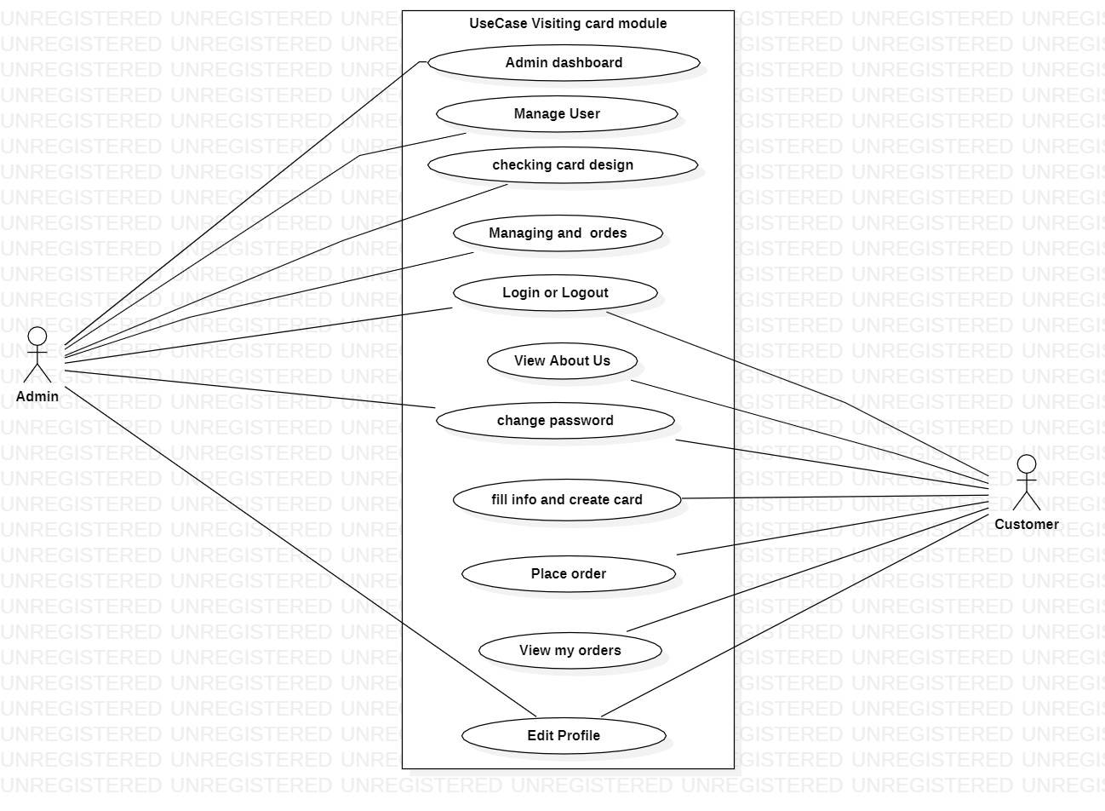
Usecase diagram

Slide 19
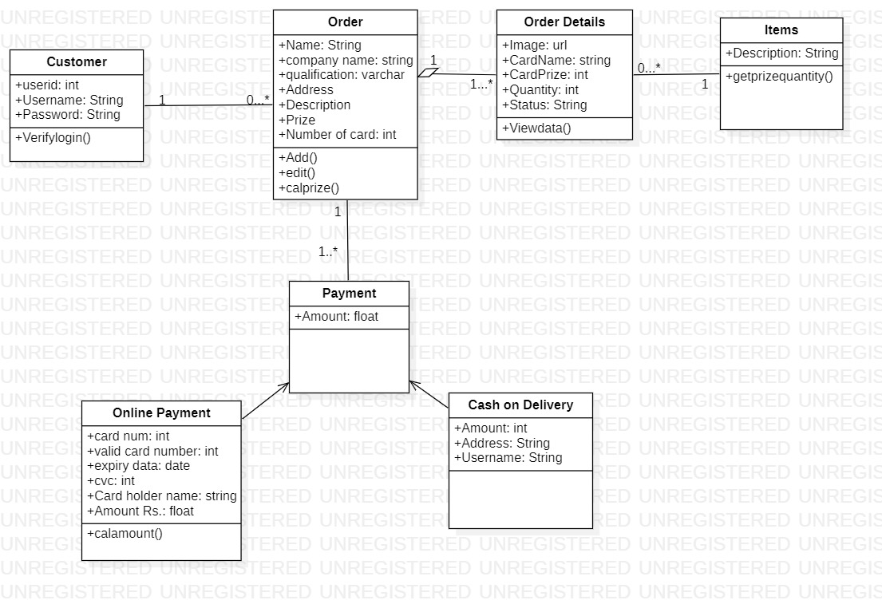
Class diagram

Slide 20
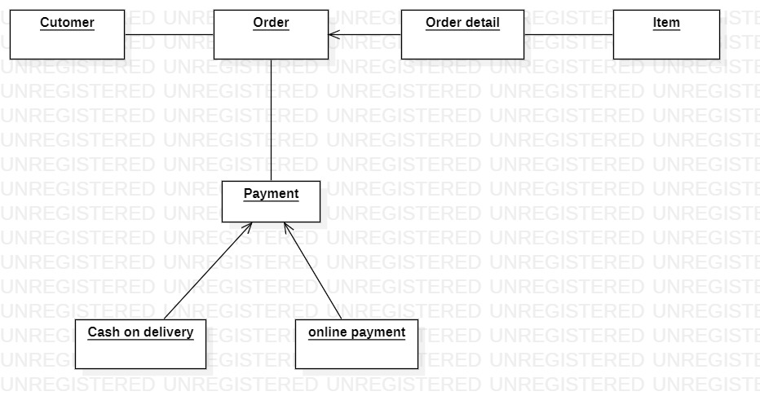
Object Diagram

Slide 21
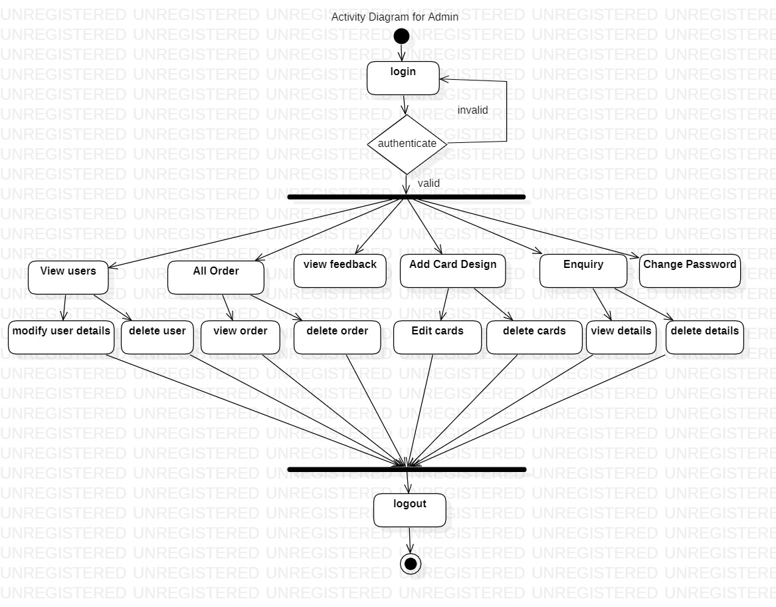
Activity diagram-Admin

Slide 22
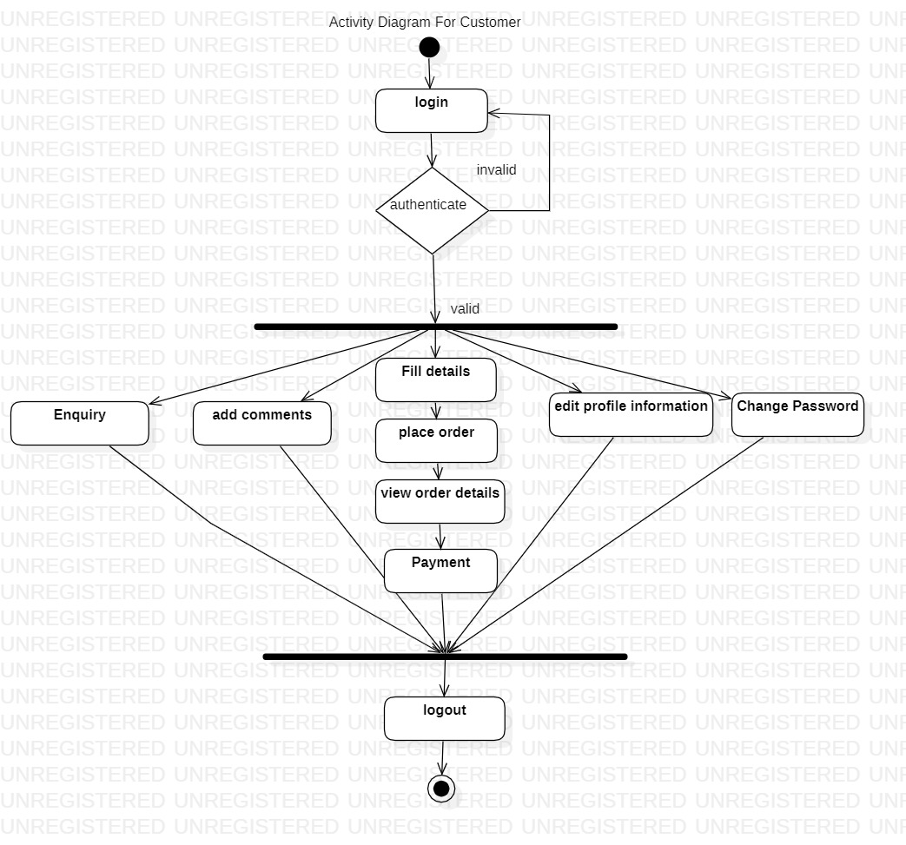
Activity Customer

Slide 23
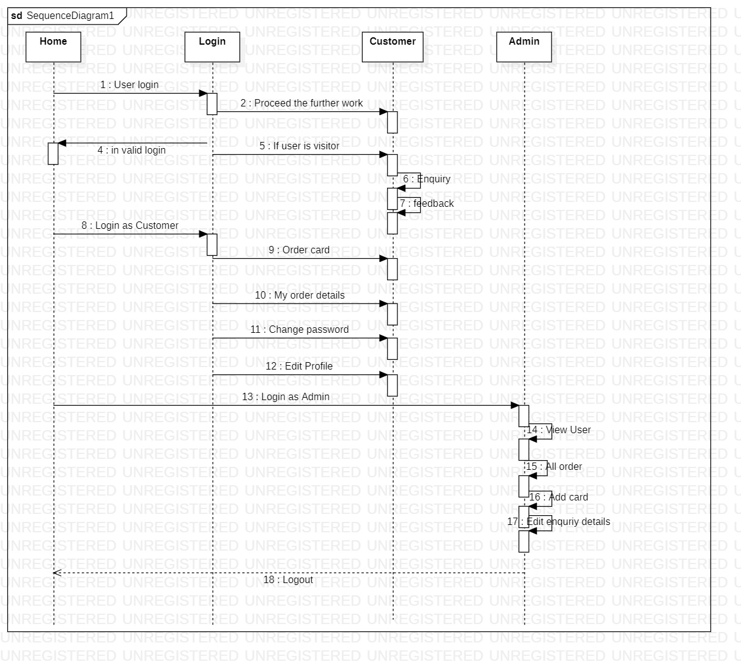
Sequence Diagram

Slide 24
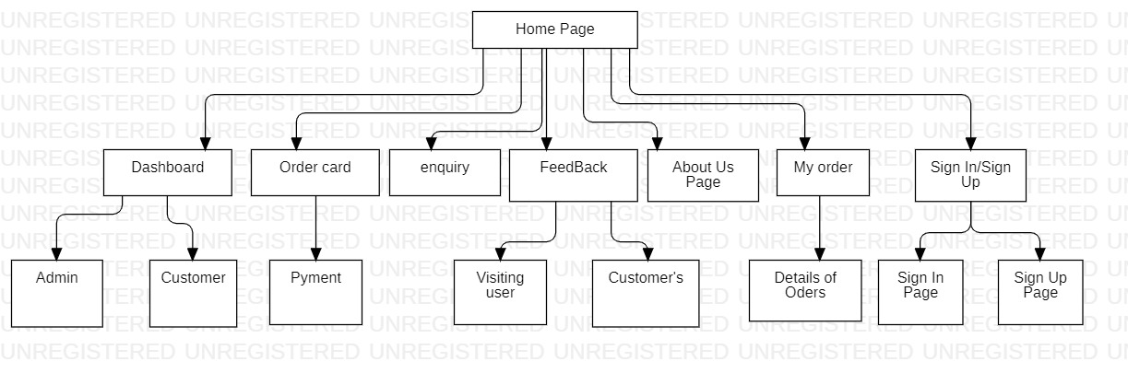
Sit-map Diagram

Slide 25
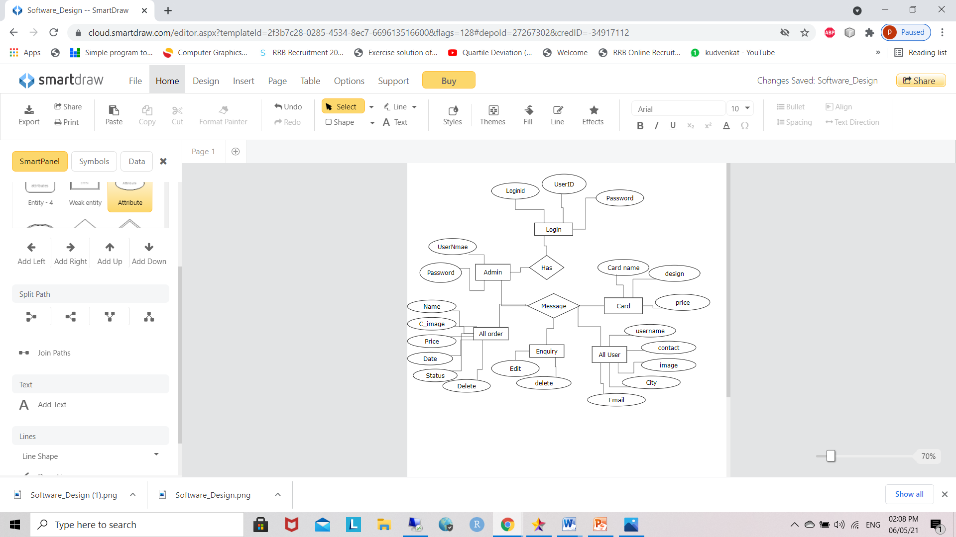
ER-Diagram

Slide 26
Schema Diagram

Slide 27
Diagram -HomePage
home
About
Contact
Enquiry
User Login

Slide 28
Admin -homepage
Admin dashboard
View User
View all order
View Feedback
Add
Card
Enquiry
Change password
Profile

Slide 29
Customer
home
Order card
feedback
My order
Logout
Enquiry
Change password

Slide 30
Test plan and test cases
Index | Title | Description | Tester Name | Developer Name
1 | Customer Sign Up & Log In | Customer sign up and login I have made by using reference from my pass web programing class assignment. This sign up and login connection I showed to my supervisor on submission of milestone 2, it works as expected. | No problem it works fine. | No problem
2 | Forms | This VISITING CARD website contains up to 7 form, for different functions, Form List: 1) Sign Up & Login 2) Order Form 3) Payment Form 4) Card Update Options 5) Transaction History Details Form 6) Admin Approval form 7) Contact Details | Validate the forms, and put every single details in the form to make user understand what they should take note. For example, below phone number column put small note to inform user that it should be remembered to proceed with payment process. | I have done validation for some columns, but the details I have put perfectly on all the forms.

Slide 31
3 | Payment Process | This payment process I was done differently on the beginning, the way is customer have to pay first before proceed with order. Then after milestone 2, my supervisor give me some idea and reference webpages that buying goods via online, to improve my payment method. The improvised version is customer can order their goods first then they need to pay the amount of their order then put the transaction number to finalise the order for delivery. | Make changes on the payment method, do some research on how can make people do it easily. | New payment method much more efficient than before.
4 | Admin Approval | Don’t make customer think they are not safe, provide details such as in progress to show them the order is on process. | Don’t make customer think they are not safe, provide details such as in progress to show them the order is on process. | The approval details is important because, as a customer who make the payment will need notification on every step we have done.

Slide 32
Profile –Test Cases
Index | Test Case | Test Data | State |  | Test Input Values | Expected Result
1. | Contact No should accept only 0-9 values | Characters except 0-9 numbers | Invalid |  | ‘sfr’ | Enter numeric values only
 |  | Numbers between 0-9 | Valid |  | 7030998907 | Input is accepted
2 | Username accept only string | Characters except | valid |  | ‘String’ | Input values is accepted
 |  | Numbers not Accept |  | Invalid | 79793709 | Enter string values
3 | Name | Numbers not Accept |  | Invalid | priti79 | Enter String values
 |  | Character except |  | Valid | ‘hello’ | Input is accepted
4 | Age | Characters except |  | Invalid | ‘hi’ | Enter numerical values only
 |  | Numbers accepts |  | valid | 22 | Input is accepted

Slide 33
5 | Birthday | Characters except | Invalid | ‘birthday’ | Enter numerical values only
 |  | Numbers accepts | valid | 22-05-1998 | Input is accepted
6 | Email | Character and numbers or special character is accepted | valid | ‘hello27@gmail.com’ | Input values accepted
7 | Zipcode | Characters except | Invalid | ‘hello’ | Enter numerical values only
 |  | Numbers accepts | valid | 400120 | Input is accepted

Slide 34
Add Card
Index | Test Case | Test Data | State | Test Input Values | Expected Result
1. | The Textbox Should contain only A-Z / a-z | Number or any other Special characters | Invalid | ‘1238as’ | This textbox only accept alphabetical characters
 |  | Alphabets between A-Z & a-z | Valid | shreya | Input is accepted
2 | The textbox should content only 2 digit | Number | valid | ‘1238’ | Input is accepted
 |  | Alphabets between A-Z & a-z | Invalid | shreya | This textbox only accept alphabetical characters
3 | Img url | Accept only Image | valid | IMG | Only accept IMG

Slide 35
Drawback and Limitation
Though the software presents a broad range of options to its users some intricate options could not be covered into it; partly because of logistic and partly due to lack of sophistication.
Time was also a major constraint this it was not possible to make the software fool proof and dynamic.
Considerable efforts have made the software easy to operate even for people who are not great with computers but it can be a little overwhelming at the first instance
The user is provided help at each step for his convenience in working with the software
List of drawbacks and limitations:
1) Website Design This website was design using basic html coding and CSS, so that it looks very simple. Most of the websites now using wordpress and also many another sites to develop a website.
2) Picture Upload In my system when customer order their card they can only upload their picture once on the time they order the card, they cannot update their picture on card update details. Nowadays people are more attached to many accounts that they can update the details easily include their profile pictures.
3) Payment Method Payment method in this system was inspired by small business via online, basically what people promote and sell using Facebook. For example people who buying goods online is contact the person and bank in the amount to purchase anything. My system also using same method for example after customer made their order they may transfer the amount to my account or cash deposit to my account. This way of buying process might be not efficient for customer.
4) Card design In my system customer can choose their card designs to be printed. Currently I have provided 4 designs for the customer, it is very limited for customers to choose. Every customer has their own design to make their card, so that they need have privileges to edit their own design

Slide 36
Proposed Enhancement
In short ,it can be summarised that the future scope of the project and the enhancements to be done maybe some of the following:
Host the software as a cloud based including more facilities
Integrate more functionality
Reduce overload of database queries
Implement backup mechanism on regular basis
A) Website Design The design of the website will upgraded into new themes and background, which makes customer catchier so that there will be many site visitor and make them buy the product. In page navigation set perfectly, to make customer easily navigate to the subpages easily
B) Picture Upload Change the card update process such as Facebook profile creating, so that customer will be able to easily update any of their information privately including their profile pictures and so on. Customer will able to owned the own profile page to share with their clients using NFC Business Card.
C) Payment Method Nowadays people who are buying goods via online are very busy, and that’s the reason the buy via online, so that in future my website will no longer need for customer cash deposit and online transfer transaction number to make their payment, they can just pay using plug-in of iPay88, it is the system that deduct money directly from customer bank account, example Digi Prepaid card buying via online.
D) Card design People nowadays need to have their own space to design their card, even people who printing paper business card also giving the printing service company many designs, in future in my system customer can design their card using their own picture and backgrounds, and they can also choose material of the card.
The above mentioned points are Enhancements which can be done to increase the applicability and the usage of this project.

Slide 37
Conclusion
Nowadays business people who using business cards are having some problems, whereby they need to find bring a lot of business cards together when they go to meet their clients, but even though they put as much information in the card, they cannot put more than 6 lines of info. Some people meets many of their clients for example marketers they provide many cards and print the card every 6 months, this makes waste of money. The objective of this system is to reduce use of paper business card, and make this Visiting Card reach people who using paper business card. Maintaining customer data in database which used to retrieve using Visiting Card. Reporting of card sales report of customer buying this Visiting Card in the database. Create a website to promote and sell Visiting Card. Write data to the Visiting Card with certain hardware. This report give readers understanding about how the system should work and how it should looks like. This report combine introduction, analysis and system requirements, design, implementation and testing and result.

Slide 38
Thank You

